Slide 1




Backup Basics with PowerShell and dbatools
Andy Levy
He/Him
Database Administrator
Benefit Resource

Slide 2

Andy
Levy
He/Him
Database Administrator
Database administrator
PowerShell fan
Open Source contributor
In IT since 1999
Web dev & server administrator
Systems integrator
Database developer
Benefit Resource
@alevyinroc
flxsql.com
andy@flxsql.com

Slide 3
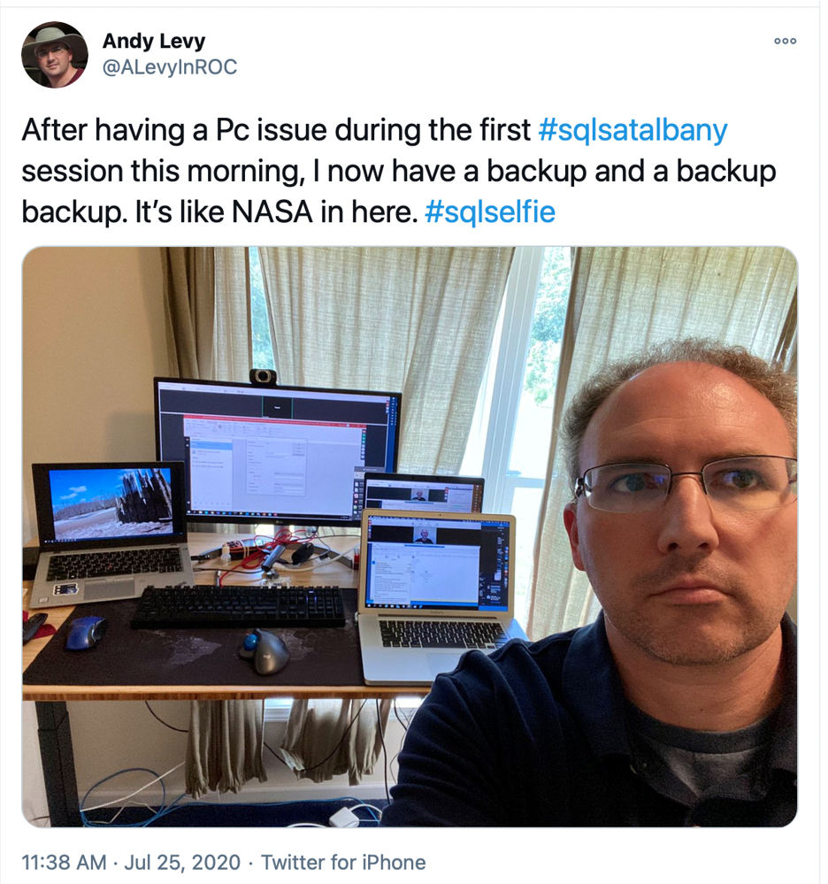
I Really Like Backups
Not just at work
Photos
Hardware
Notes:
SQL Saturday Albany story

Slide 4
Why PowerShell?
Clicks don’t scale
Clicks aren’t repeatable
Large module ecosystem

Slide 5
Why dbatools?
By DBAs, for DBAs
Open Source
Compatibility
Well-tested
Well-documented
632 functions!
Notes:
Chrissy origin story
Signed module
503/632 functions run on macOS, 504 on Raspberry Pi

Slide 6
dbatools Advantages
Frequent releases
Scalable across the estate
On-premises & Azure
The hard work is already done

Slide 7
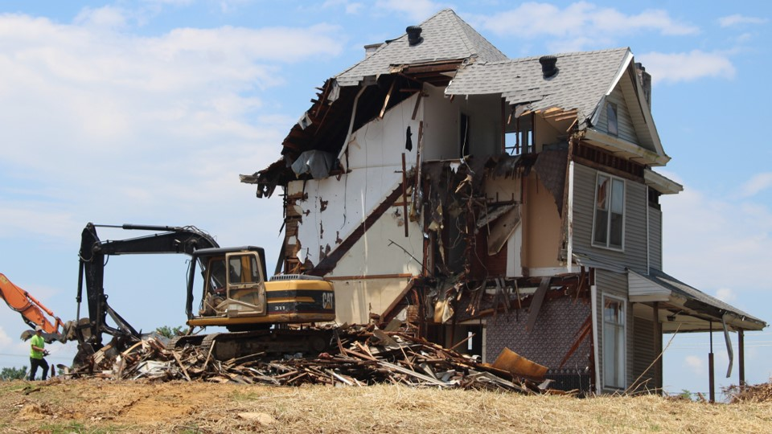
Demo Time!
https://unsplash.com/photos/ivHVZCmm5wY

Slide 8
Closing Thoughts
Get to Carnegie Hall
Save & share your scripts
Explore
Take the next step

Slide 10
https://flxsql.com/summit2021
Andy Levy
@alevyinroc
flxsql.com
andy@flxsql.com

